Slide 1
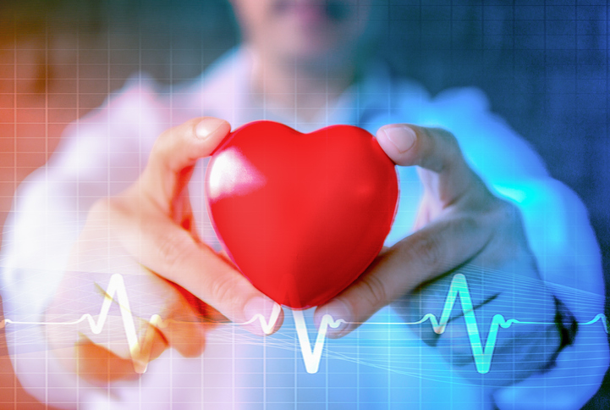


Project 3 : Prediction of Cardio-Vascular Diseases Koh Si Ting

Slide 2
Agenda
Dataset
Tools & Methodology
Model Comparison
Model Evaluation
Conclusion & Insights
Notes:
This is my agenda for my presentation. I will startoff with dataset, then the tools and metholody I used for modeling then move on to model comparison and evaluation and I will end off with my conclusion and insights.

Slide 3


Cardio-vascular Diseases (CVDs) : Disorders of heart and blood vessels
Number 1 cause of death globally
Most CVDs can be prevented by addressing to risk factors
Notes:
So just a little background on Cardiovascular disease
According to World Health Organization (WHO), it is the Disorders of heart and blood vessels, and includes conditions like hypertension (high blood pressure) coronary heart disease (commonly known as heart attack)
They are the number one cause of death globally
One thing to note is that most Cardiovascular disease can actually be prevented by addressing behavioral risk factors such as smoking, obesity, physical inactivity and alcoholism. And this come to my motivation for my project.
Some of you guys already know I am an- ex nurse and I was actually in cardiology and cardio-thoracic vascular surgery dep. Therefore, it motivates me to predict CV diseases which can helps in early diagnosis and medical treatment that can improve prognosis.

Slide 4
Dataset
Original Dataset (from Kaggle)
No. of Records | 69,300
No. of Features | 12
Types of Features | Objective: factual information Examination: results of medical examination Subjective: information given by the patient.
Target | Presence or absence of cardiovascular disease
Notes:
For my dataset, I have gotten it from Kaggle, the no. of records is 69300 and no of features is 12. This consist of Objective, Examination and Subjective features.
And our target will be Presence or absence of cardiovascular disease
This pie graphs shows that my dataset is pretty much balanced for my modeling which I will be elaborated more later.

Slide 5

Tools
Pandas : Dataframes
Numpy : Transforming data
Scikitlearn : Supervised ML Algorithms
Matplotlib & Seaborn : Plot graphs
Flask: App creation
Notes:
Just quickly go through the tools I have used for this project: pandas

Slide 6
Methodology
EDA + Feature Engineering & Selection
Train, Validate and Test Models & Model Selection
Evaluation of Chosen Model
Drop outliers, duplicate, correlated features
Calculated Body Mass Index (BMI)
Use RandomForest for feature selection
Use RandomSearch CV (CV=5) to tune hyper-parameters (except Naive Bayes)
Comparison: Accuracy, ROC-AUC score, Log-loss and F1-score
Confusion matrix
Model Performance
ROC curve
Precision & Recall Graph
Notes:
For the methodology I used for this project, I started off with simple data cleaning and EDA.
In my original dataset, height and weight seems uncorrelated with the target therefore I included a calculated field of Body Mass Index (BMI) which can help to train my model. Then I used Randomforest to help me in feature selection.
Moving on to training and testing my model, I used randomsearchCV to tune my hyper-parameters, as my dataset is on the larger side…except for Naïve Bayes as there isn’t any hyper-parameter to tune. Then I compared my models based on their accuracy, AUC score, log loss and F1-score.
Lastly, onto evaluation of my chosen model, I will explain more on the confusion matrix and talk more on its performance

Slide 7
Data Information
Final Dataset
No. of Records | 69,260
No. of Features | 7
Features kept for modelling | Age BMI Blood Pressure Physical activity Glucose Level Cholesterol Level
Insignificant Features to drop | Height Weight Gender Alcohol Intake Smoking
Notes:
So this is some information on the final dataset I used to create my models. As you can see from graph beside on the feature importance, you can infer that the top 3 features in predicting of CV diseases are BMI, Systolic BP and age.

Slide 8
Notes:
so lets compare on the models I have tried. They includes logistic regression, K nearest neighbor, support vector machine (SVM) algorithm, navie bayes, decision tree and randomforest.

Slide 9
Notes:
First for accuracy, randomforest has done the best among all.

Slide 10
Notes:
Moving on to AUC and F1-score. For AUC, the Higher the score is, the better my model is at predicting and distinguishing between people with disease and no disease.
And for F1-score which is a average of precision and recall, it shouldn’t be so high if one measure is improved at the expense of the other.

Slide 11
Notes:
On that note, randomforest has also done better than others, in terms of AUC score.

Slide 12
Notes:
Lastly on their log-loss function, which is a measure that considers the confidence of the prediction when assessing how to penalize incorrect classification. The lower Log Loss, the lower the uncertainty of my model. is

Slide 13
Notes:
Therefore, looking for the lowest value, is still random forest

Slide 14
Confusion Matrix (RandomForest)
N= 13653 | Predicted : 0 | Predicted : 1
Actual : 0 | TN: 5436 | FP: 1453 | 6889
Actual : 1 | FN: 2210 | TP: 4554 | 6764
 | 7646 | 6007
Legend
TP: True Positive
TN: True Negative
FP: False Positive
FN: False Negative
Notes:
Therefore I chosen Randomforest for my model.
So, this is the confusion matrix I got with the default threshold of 0.5. and let me will talk more about this.
0: negative class, 1: positive class
True positive (TP): Prediction is positive and person has disease, we want that
True negative (TN): Prediction is negative and person does not have diseases, we want that too
False positive (FP): Prediction is positive but person does not have diseases, false alarm, bad,
False negative (FN): Prediction is negative but the person has diseases, the worst
For this dataset, false positives like I mentioned, are just false alarm. With a 2nd more detailed scan it can be corrected. But a false negative label will mean that they think they’re healthy when they’re not, which is — in our problem — the worst case which we don’t want
Therefore, I choose to focus on Recall (aka Sensitivity).This is because the idea of false positives is far better than false negatives, in other words, I would rather get some healthy people labeled with diseases and send them for a 2nd test for confirmation over missing out a person with disease but labeled healthy and in turn totally delaying the treatment which the person should have gotten. Thus, I will adjust my threshold such that FN can be lower and TP can be higher, in order to optimize my recall.

Slide 15
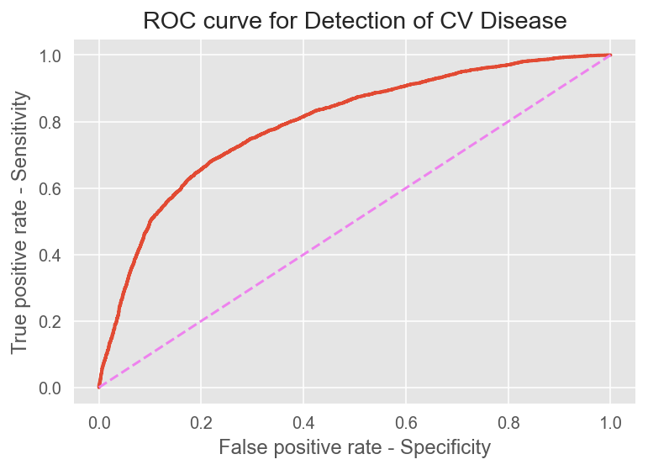
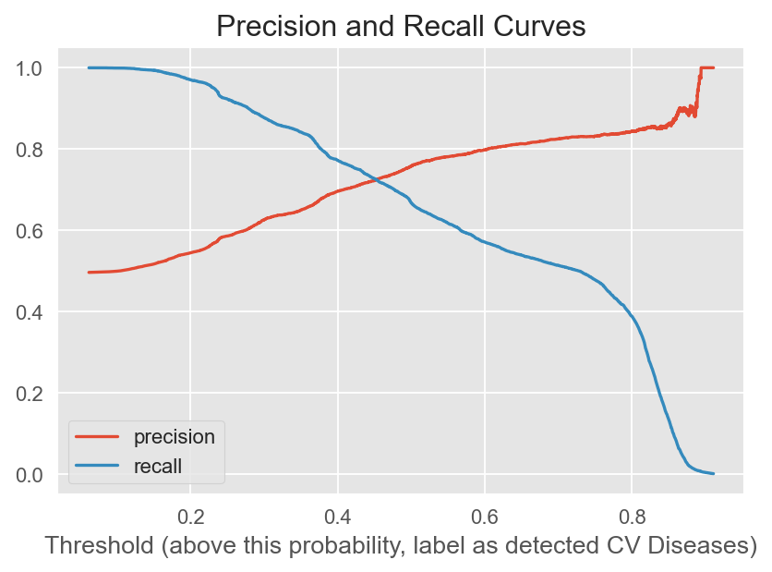
Model Chosen: RandomForest
ROC-AUC Score = 80%
Threshold = 0.4 - 0.5
Notes:
Before I tried to adjust my threshold to optimize my recall for my model, I plotted the Precision and Recall curve help me decide the threshold value. As you can see from graph, the threshold should be around 0.4 to 0.5.
Specificity is the correctly -ve labeled by the program to all who are healthy in reality.
Recall (aka Sensitivity) is the ratio of the correctly +ve labeled by our model to all who have CV diseases in reality.
Precision is the ratio of the correctly +ve labeled by our model to all +ve labeled.

Slide 16
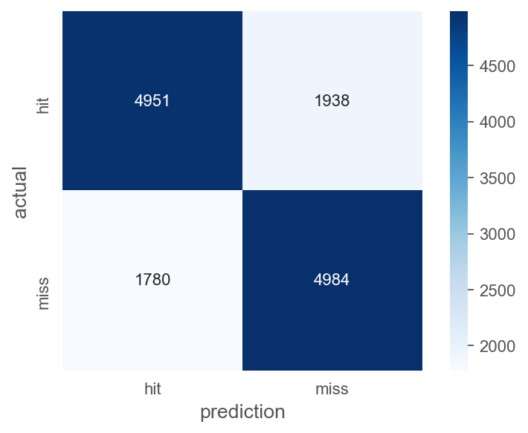
Model Performance & Evaluation
Performance Results
Threshold | 0.44
Accuracy | 73.2%
Precision | 72.0%
Recall (Sensitivity) | 73.7%
Specificity | 71.9%
F1-score | 0.71
Notes:
After tuning my threshold, I decided to set my threshold at 0.44, for slightly better recall but at the same time, not compromising on my precision result. For performance wise, let’s take a look at this table here.
— Accuracy value of around 70% means that 7 out of every 10 predicts are correct but 3 are wrong.
— Precision value of around 70% means that on average, every 7 out of 10 who predicted with disease really do have the disease but 3 are actually healthy.
— Recall value is 70% means that 3 of every 10 people with disease in reality are missed-predicated as healthy — Specificity value is 70% means that 3 out of every 10 healthy people in reality are miss-predicted with disease
Not too bad, but also not so good, which brings me to my conclusion and insights.

Slide 17
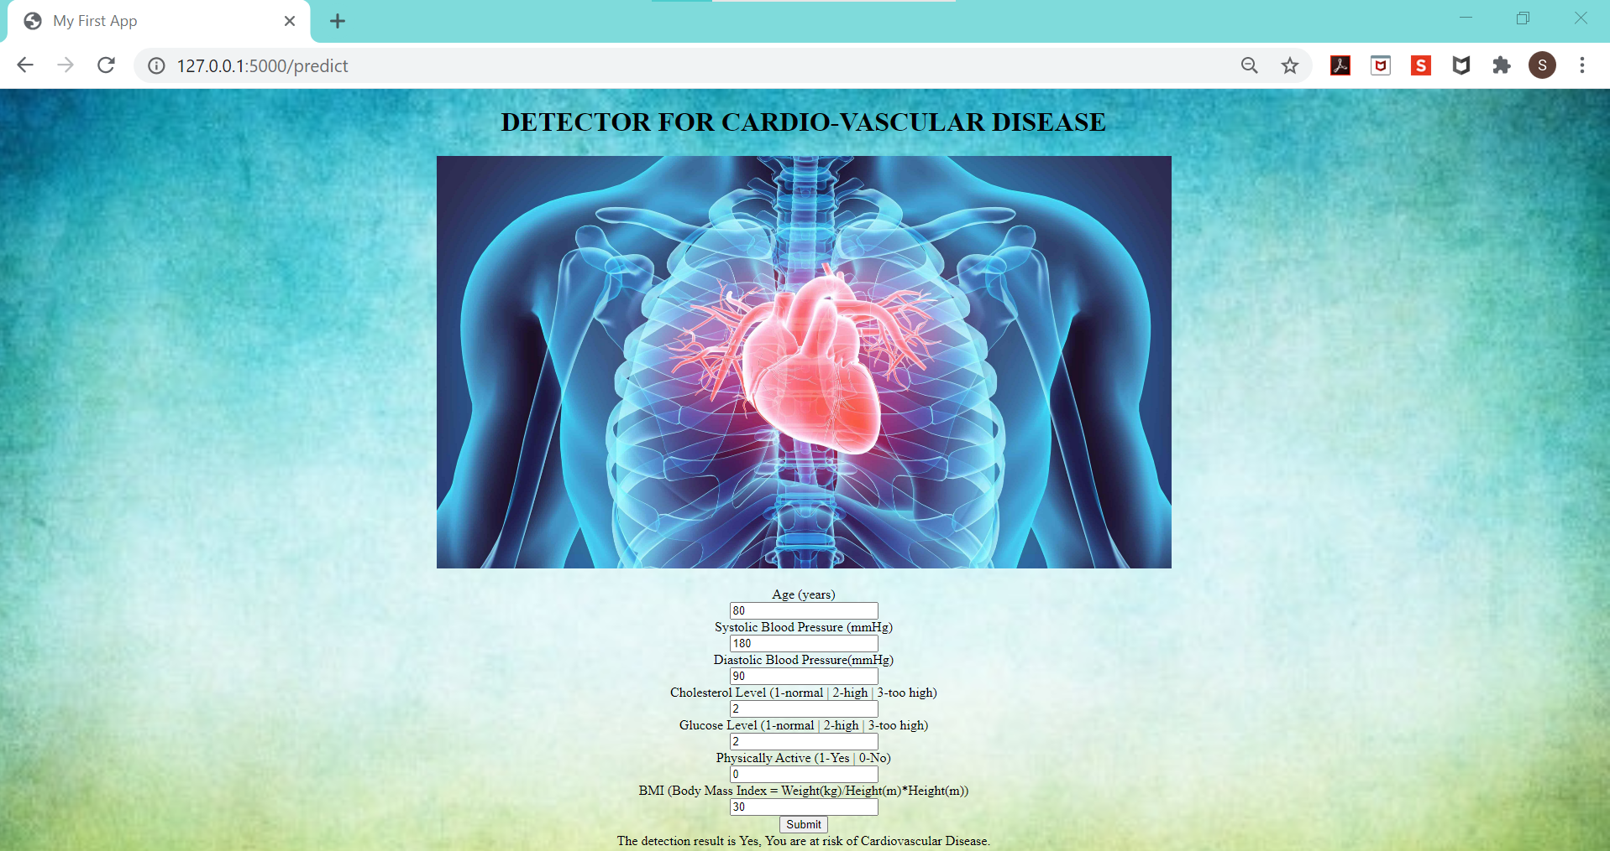
Notes:
Before I end off, I would like to just share with yall on my very simple app which I created to detect cardiovascular diseases based on my model but there are still alot modifications to improve on. If I have more time, I would like to improvise it such that it can produce result on how much percentage is the person at risk of the disease. For now, my model can tell you only whether yes or no if you are at risk.

Slide 18
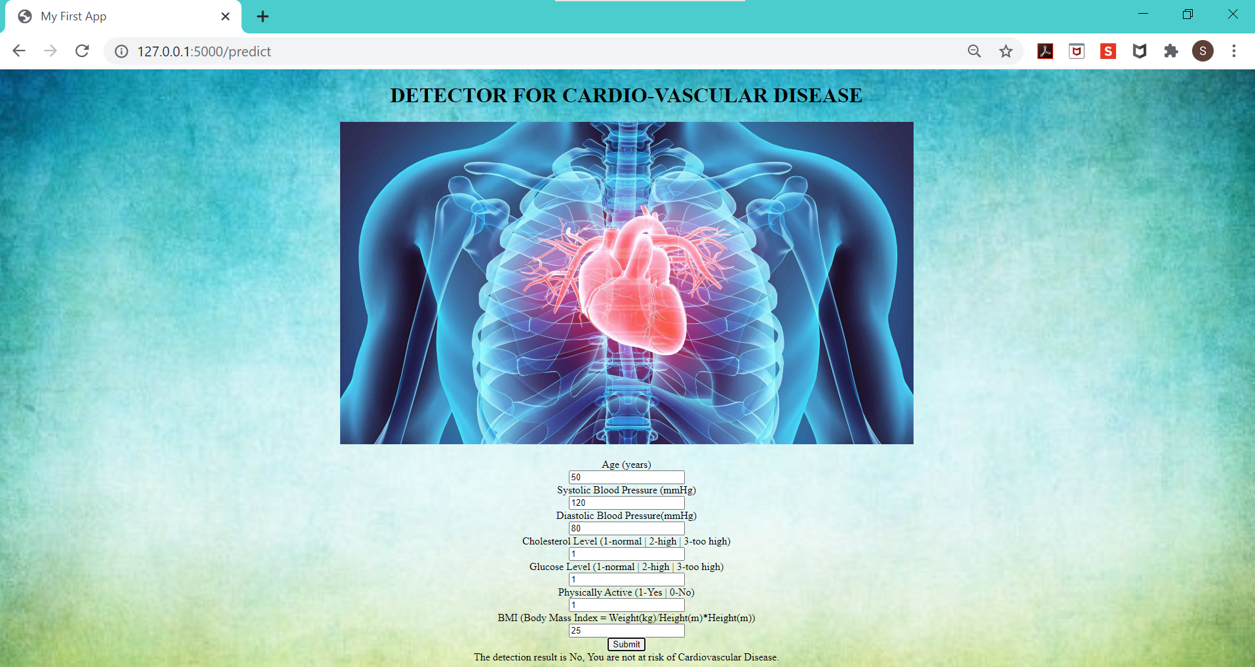

Slide 19
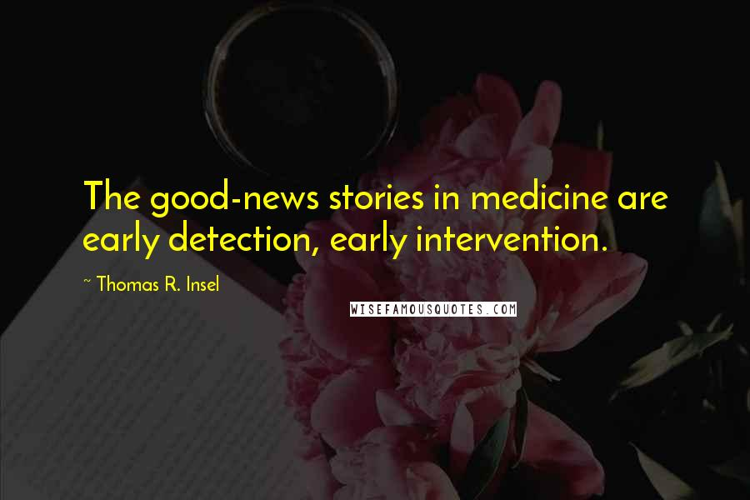
Conclusion & Insights
Diagnosis of CV diseases involves comprehensive workups
Limitation of Model: Lack of such features
An early detection of CV diseases in term of identifying people with high risk in getting CV diseases
Notes:
Being an ex cardio nurse, one thing I am certain is that the diagnosis of Cardiovascular disease involves comprehensive workup which comprises of scans, specific blood tests and even invasive procedures, in which all of them are not included in my model. Therefore, I would say that my model is more appropriate to serve an early detection of CV diseases based on the person’s demographic details and behavioral lifestyles. This helps in identifying people with high risk in getting CV diseases and addressing to their risk factors early (like I mentioned earlier) it can help to prevent CV disease or to help the person receive early medical intervention which can definitely improve the prognosis of the condition. Like the quote always say the good-news stories in medicine are early detection and early intervention.

Slide 20




Thank you!
References
https://www.kaggle.com/sulianova/cardiovascular-disease-dataset
https://www.who.int/cardiovascular_diseases/about_cvd/en/#:~:text=Definition,cerebrovascular%20disease%20(stroke)
https://www.news-medical.net/health/Cardiovascular-Disease-Diagnosis.aspx#:~:text=Cardiovascular%20diseases%20are%20diagnosed%20using,results%20from%20tests%20and%20procedures.

